Slide 1
Air and Flight

Slide 2
Mystery Bag
Study the substance/material
What is in the box?

Slide 3
We live at the bottom of an ocean – an ocean of air.
Approximately 450 kilometres deep, this mixture of gases, called the atmosphere, surrounds Earth and extends far into space.

Slide 4
Air is made of invisible gases that you cannot smell, taste or touch.
78% nitrogen
21% oxygen
1% argon
…and trace amounts of carbon dioxide, water vapour, neon, helium, hydrogen, methane and xenon
With the exception of hydrogen, all gas particles are attracted to Earth by gravity – this explains why our ocean does not drift off into space.

Slide 5
Experiment Outline
Question
Collect Information
Hypothesis
Materials
Procedure
Manipulated Variable-the thing that you change in your experiment
Constant variable-the thing that stays the same
Responding Variable- the outcome that is changed because of the manipulated variable
Labeled Picture of Experiment
Observations
Inferences

Slide 6
Labeled Picture of Experiment
Observations
Inferences

Slide 7
I can prove that air takes up space and exerts pressure
I can identify examples of this in everyday applications

Slide 8
Air Pressure:
- The closer to the earth you get, the greater the air pressure
- Air pressure (atmospheric pressure) is all around you
- Air pressure is the force exerted on you by the weight of tiny particles of air (air molecules)
- Air does not squish you because why? You have air inside your body and that balances with the air pressure outside of you

Slide 9
-Ear popping -As the number of molecules of air around you decreases, the air pressure decreases.
-This causes your ears to pop in order to balance the pressure between the outside and inside of your ear.

Slide 10
Diving Paper
Materials:
Student: Piece of paper – experiment outline
Teacher: Page 9, sheet of paper, glass, clear bowl filled with water
See notes next page

Slide 12
Diving Paper Notes
The air takes up space so there is no room for the water to flow into the cup.
The water pressure compressed with the air allowing some water into the glass.
When the air pressure in the glass equaled the pressure exerted by the water, no more water could get in and the paper stayed dry.

Slide 13
Huff N’ Puff
Materials:
Student: Piece of paper – experiment outline
Teacher: Page 10, deflated balloon, plastic pop bottle
See notes next page

Slide 14
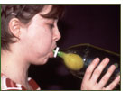
Huff N’ Puff Notes
As you inflate a balloon, it takes up more space.
The bottle is already full – of air.
Even though you can’t see it, air takes up space.
When you try to inflate the balloon, the air trapped inside the bottle prevents you from doing it.

Slide 16
A-Weigh We Go

Slide 17
Air Takes up Space!

Slide 18
I can provide evidence that air is a fluid and is capable of being compressed/packed together
I can identify examples of this in everyday applications

Slide 19
Taking the Plunge
Materials:
Teacher: Page 20-21, syringe
What is the plunger pushing?
Why is it so difficult to push it all the way in?

Slide 20
Let it Shine
Materials:
Student: Piece of paper – experiment outline
Teacher: Page 23-24, tin can, drinking straw, jar lid, candle, plasticine
See notes next page
Video

Slide 21
Let it Shine Notes
The air moving around the can is at a lower pressure than the still air.
This low pressure moving air is pushed quickly around the can towards the flame –by the still air – high pressure

Slide 22
Adjust the Volume
Materials:
Student: Piece of paper – experiment outline
Teacher: Page 27-28, small balloons, two tubs for water, bag of ice, two pop bottles, hot water
See notes next page

Slide 23
Adjust the Volume Notes
The amount of air in the bottles did not change.
The air temperature changed causing the air to expand and contract.
The hot air expands and needs more space causing the balloon to “blow up.”
The cold air condenses and takes up less space, causing the balloon to deflate. Try switching bottles…

Slide 24
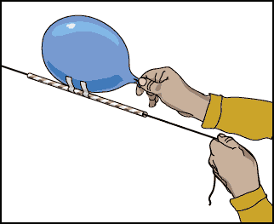
Balloon Rockets ***See page 19
Question- What happens when you compress air?
Materials- string, balloon, straw, tape
Procedure:
1) Tape a long piece of string between 2 points
2) Attach an inflated balloon to the straw sliders with tape.
*** Don’t tie the balloon!
3) Move the balloon to one end and LET GO!

Slide 25
Balloon Rocket Notes
Conclusion- When you blow up a balloon you are compressing air inside the rubber skin. When you let go, the air is forced out through the neck. This forces the balloon in the opposite direction.

Slide 26
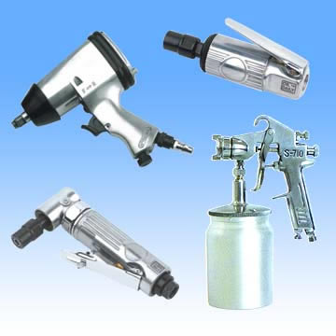
Everyday Uses of Compressed Air

Slide 27
I can recognize in order for devices or living things to fly, they must have sufficient lift to overcome the downward force of gravity.
I can describe and demonstrate instances in which air movement across a surface results in lift – Bernoulli’s principle

Slide 28
About 250 years ago, a Swiss mathematician, Daniel Bernoulli, explained how fluids (like water or air) flow.
As the speed of a fluid increases, the pressure it exerts decreases.
Because air moves over the curved top of the wing faster than it moves along the underside of the wing, there is less air pressure above the wing, more below, and lift is created.

Slide 29
Bernoulli’s Principle
Experiments in workbook
When the speed of a fluid is low (water or air), the pressure is high.
When the speed of a fluid is high the pressure is low.
The faster the air moves across a surface, the lower the air pressure.

Slide 30
Lift Off
Record your Observations:
Bernoulli’s Principle explains that fast moving air creates an area of pressure lower than air that moves more slowly. As you blow over the paper you are creating a low pressure area and the paper is forced up by higher pressure. This phenomenon is called Lift

Slide 32
Bernoulli’s Principle

Slide 33
I can identify adaptations that enable birds and insects to fly.
I can describe the means of propulsion (force/thrust) for flying animals and for aircraft.

Slide 34
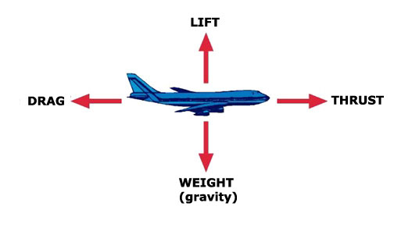
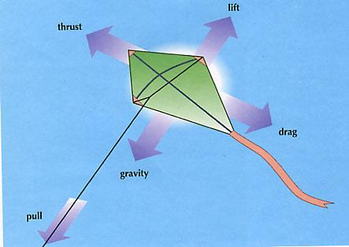
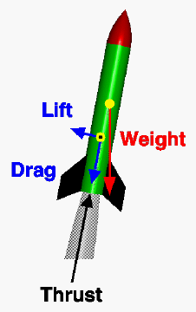
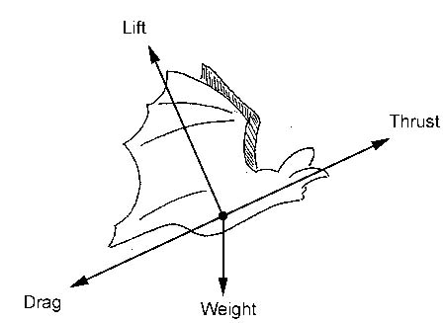
Four Forces of Flight

Slide 36
Four Forces of Flight
Lift – Upward force which acts against the force of gravity
Drag – Resistance or friction that acts to slow down an object as it moves through a gas or liquid
Thrust – The force that causes an object to move forward
Gravity – Downward force which acts against the force of lift. This force increases as the mass of an object increases

Slide 37
Student Workbook
Master # 7 – What Holds an Airplane Up?
- draw diagrams and labels to go along with the facts
Master #8 – Flying Things
- Brainstorm, in groups of 5
Master #9 – Fly Like a Bird
- draw diagrams and labels to go along with the facts
Master #10 – Specialties of a Bird
-Research, in lab, a birds wing
Master #11 – Fly Like an Insect
- draw diagrams and labels to go along with the facts
Master #13- Adaptations
Master #14- Why Can’t they Fly
-computer lab

Slide 38
Bird Adapations

Slide 39
I can recognize that streamlining reduces drag.
I can predict the effects of specific design changes of a model aircraft or aircraft components.

Slide 40
Paper Drag
Materials:
Student: 2 pieces of paper per group
Teacher: Page 66
See notes next page

Slide 41
Paper Drag Notes
The crumpled piece of paper hits the floor first because of the differences in the amount of friction (drag) between the paper and the particles on the air.
The crumpled piece of paper has a smaller surface area.
The flat piece of paper must push a greater amount of air out of the way to fall through the air.

Slide 42
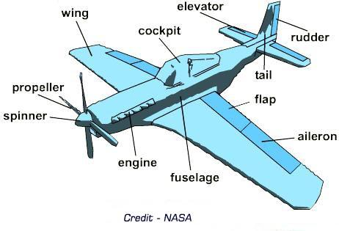
Parts of an Airplane

Slide 43
Dart and Drag
Materials:
Student: Piece of paper
Teacher: Page 72-73
Test: move different parts of the plane. What happens?

Slide 44
I can recognize that air is composed of different gases and identify the evidence for different gases.

Slide 45
Fruity Oxidation
Materials:
Student: Experiment Outline
Teacher: Page 74
See notes next page

Slide 46
Oxidation Notes
Rusting is oxidation. Oxygen in the air reacts with the chemicals on the surface of the object. The oxygen replaces other substances.
A clue to the presence of oxygen is a brownish color.
How can you slow down oxidation???

Slide 47
Air Websites
http://www.grc.nasa.gov/WWW/K-12/airplane/short.html
Basic Aerodynamics: http://www.slideshare.net/azfa/basic-aerodynamicsppt
http://www.learner.org/jnorth/tm/FlightLesson.html

Slide 48
Air and Flight
FLIGHT

Slide 49
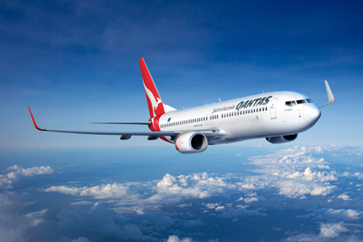
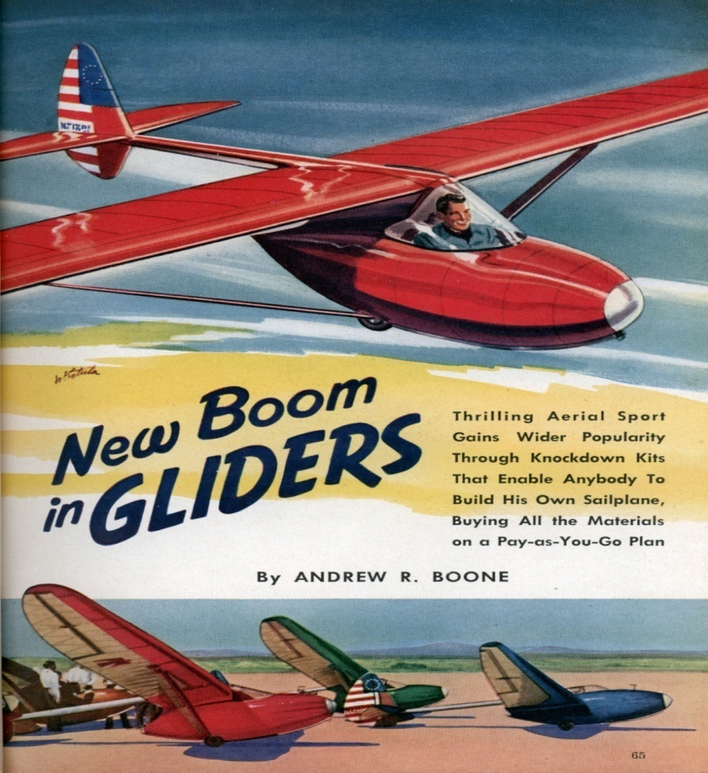
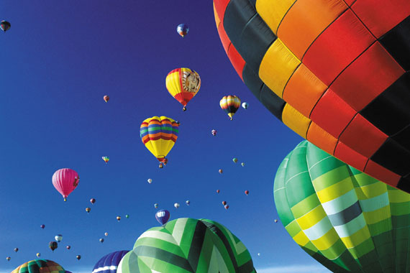
FLIGHT!

Slide 50
Lesson 1- What Flies
-Turn to “Sort it Out” in your book
In groups of 5, brainstorm everything that flies

Slide 51
Sort It Out!
Floater- does not really fly, the wind controls its speed and direction of flight
ex) balloons, parachutes, bubbles
Gliders- Are anything where its wings interact with the wind or moving air. Gliders always finish lower then they started
ex) paper airplanes, flying squirrels, hang gliders
Powered Flyers- use an engine or energy to fly or gain altitude
ex) insects, planes, birds

Slide 52
I can conduct tests of a model parachute design and identify design changes to improve the effectiveness of the design.

Slide 53
What is Drag?
Drag (sometimes called air resistance, a type of friction, or resistance) is a force acting opposite to the motion of any object moving in the air
Example. Parachute

Slide 55
Breaking your Fall/Take it to the Limits
Materials:
Student: grocery bags, paper, tape, paper clips, string, scissors
Teacher: Page 7-10
Challenge-
In groups of 3 create a parachute that will stay the longest in the air
Variables to Manipulate- the canopy, the load and the length of the shroud lines
*** Record your finding on “Chute Tests”

Slide 56
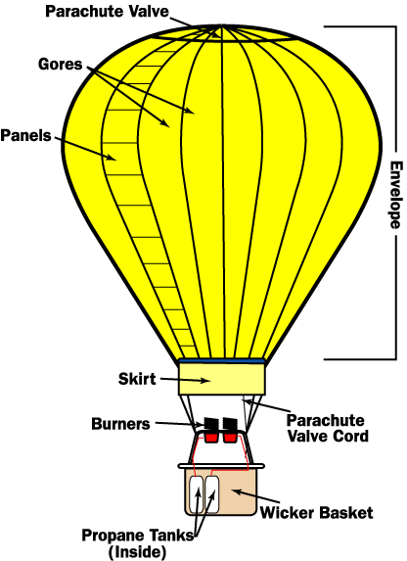
Complete Lighter Than Air

Slide 58
Complete Lighter Than Air

Slide 59
I can describe the design of a hot air balloon and the principle by which rising and falling of a hot air balloon are controlled.

Slide 60
Hot Air Balloons
Operate on Archimedes Principle which states that objects suspended in a fluid have a buoyant force equal to the weight of the fluid displaced.

Slide 61
How they work…
Burner ignites and warm air expands and fills the envelope, pushing out cooler air
When the weight of the air inside and outside of the balloon is equal, the balloon suspends
When the air on the outside of the balloon exceeds the weight of the rig, the hot air balloon is said to have a buoyant force and rises

Slide 62
How they work cont’d…
To keep the balloon aloft, a blast from the burners is given every 30 seconds
As the air inside the balloon cools and contracts, the balloon loses altitude since less air is being displaced

Slide 63
How they work cont’d…
To allow for quick descent, a Velcro vent at the top of the balloon can be opened by means of a rope, speedily dispelling warm air
The lateral movement of the balloon is at the mercy of the prevailing winds

Slide 64
How it works…
When air is heated, it expands; therefore, weighing less by volume than cooler air. Cold air is denser than warm air, so warm air will float on top of cold air.
The hot air balloon keeps the cold and warm air from mixing, permitting colder, denser air outside the balloon to support the mass of the balloon and keep it aloft.

Slide 65
How it works cont’d
As the air inside the balloon cools, the balloon loses altitude. To allow quick decent, a Velcro vent at the top of the balloon can be opened using a rope.

Slide 66
I can conduct tests of glider designs, and modify a design so that it will go further, stay up longer, or fly in a desired way (ex. fly in a loop, turn to the right)
I can recognize the importance of stability and control to aircraft flight and design, construct and test control surfaces.
I can apply appropriate vocabulary in referring to control surfaces and major components of an aircraft.
*Vocabulary needed: fuselage, vertical and horizontal stabilizer, aileron, rudder etc…

Slide 67
Torrey Pines is a state park and launch site for paragliders in San Diego, California. Occasionally these paragliders bring along some special friends.
http://www.parahawkusa.com/Home.html

Slide 68
Making a Glider
Materials:
Student: 8 ½ x 11 paper, tape, Page 20
Teacher: Page 15 & 54-59

Slide 69
Parts of an Airplane
http://www.learnalberta.ca/content/setf/HTML/StudentResource/source/topic_two.html
See- Lesson 1

Slide 71
Using your notes and our discussion please complete “Airplane Control Surfaces”

Slide 72
Controlling Pitch, Roll & Yaw
Longitudinal axis runs from the nose to the tail – rocking side to side on this axis is roll
Vertical axis runs from the top to the bottom of the fuselage – nose swinging left to right is yaw
Lateral axis runs from wing tip to wing tip – teetering up and down on this axis is pitch

Slide 73
Using your notes and our discussion please complete “Aircraft Components”

Slide 74
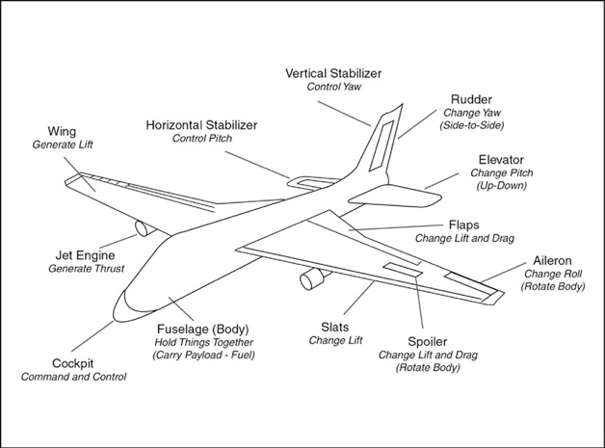
t.

Slide 75
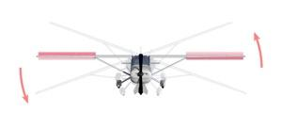
Controlling Roll
Ailerons Controls Roll On the outer rear edge of each wing, the two ailerons move in opposite directions, up and down, decreasing lift on one wing while increasing it on the other. This causes the airplane to roll to the left or right. To turn the airplane, the pilot uses the ailerons to tilt the wings in the desired direction.

Slide 76
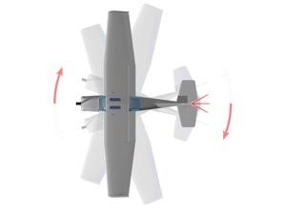
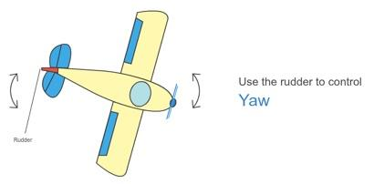
Controlling Yaw
The Rudder Controls Yaw On the vertical tail fin, the rudder swivels from side to side, pushing the tail in a left or right direction. A pilot usually uses the rudder along with the ailerons to turn the airplane.

Slide 77
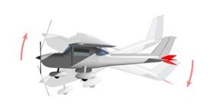
Controlling Pitch
The Elevator Controls Pitch On the horizontal tail surface, the elevator tilts up or down, decreasing or increasing lift on the tail. This tilts the nose of the airplane up and down.

Slide 78
What does a plane’s “Tail Fin” do?
A vertical stabilizer, or tail fin, keeps the airplane lined up with its direction of motion. Air presses against both its surfaces with equal force when the airplane is moving straight ahead. But if the airplane pivots to the right or left, air pressure increases on one side of the stabilizer and decreases on the other. This imbalance in pressure pushes the tail back into line.

Slide 79
What is an airplane’s “Rear Wing” for?
Like the vertical stabilizer, the horizontal stabilizer helps keep the airplane aligned with its direction of motion. If the airplane tilts up or down, air pressure increases on one side of the stabilizer and decreases on the other, pushing it back to its original position. The stabilizer also holds the tail down, countering the tendency of the nose to tilt downward — a result of the airplane’s center of gravity being forward of the wing’s center of lift.

Slide 80
Lesson 6- Propulsion and Types of Planes
http://www.learnalberta.ca/content/setf/HTML/StudentResource/source/topic_three.html
Lesson 4

Slide 81
Types of Airplanes
Complete “Types of Airplanes” sheet
Answer Key: White, SAM binder

Slide 82
I can construct and test propellers and other devices for propelling a model aircraft.

Slide 83
Flying Rabbits
Materials:
Student: Master #9
Teacher: Page 30-31
-Students can construct the flying rabbits from construction paper – they do not need the template of them

Slide 84
I can describe the differences between aircraft and spacecraft and identify reasons for the design difference

Slide 85
 | Spacecraft | Aircraft
How do they achieve lift? | Since there is no air in space, Bernoulli’s Principle does not apply. Spacecraft generates thrust through 2 large rocket boosters and 3 engines. The engines burn liquid oxygen and hydrogen. The fuel for the engines is stored in a large tank attached to the shuttle. After lift-off, the fuel tank is detached from the shuttles. | An airplane achieves lift by first generating thrust, which then creates enough speed to achieve lift.
Inside the craft | Spacecrafts are designed to meet the needs of the astronauts. Astronauts need air to breathe, food, water and a warm temperature. | Carries people and cargo.
How do they land? | To come back to Earth, the shuttle needs position itself to come through the earths atmosphere. The shuttle is moving so fast that larger amounts of heat are generated from the friction of air molecules. Spacecraft are designed to be protected from the heat. They have reinforced carbon-carbon on the wings surface and underside, high temperature black surface insulation tiles on the upper forward fuselage and around the windows, and low temperature white surface tiles on the remaining areas. When the spacecraft enters the atmosphere, the shuttle is able to fly like an airplane. | Position the elevators up so the tail goes up and the nose goes down.
Wings | Spacecraft have wings that can generate lift when needed.

Slide 86
 | Design Differences | Reasons for Design
Aircraft | -Wings -Propeller or jet engines -Wheels | -Provide lift in air -Provide thrust using air -For landing on a runway
Spacecraft | -Rocket engines -Heat shield | -Release burned fuel for propulsion, as no air in space -to protect passengers upon re-entry

Slide 87
Spacecraft VS Aircraft
Using your notes and our discussion please complete the Venn Diagram in your book

Slide 88
Aircraft VS Spacecraft
http://www.wydea.com/

Slide 89
Websites
http://www.grc.nasa.gov/WWW/K-12/airplane/short.html
Basic Aerodynamics: http://www.slideshare.net/azfa/basic-aerodynamicsppt
http://www.learner.org/jnorth/tm/FlightLesson.html
http://www.learnalberta.ca/content/setf/HTML/StudentResource/source/topic_four.html

