Slide 1
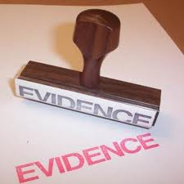
SCIENCE EVIDENCE & INVESTIGATION

Slide 2
A crime has been committed! The police are called to the crime scene to investigate. Evidence must be carefully collected and analyzed. To convict, the forensic evidence must prove the suspect guilty beyond a shadow of a doubt!
The process of investigation and the gathering of evidence are the essence of science inquiry. This unit emphasized questioning, predicting, observing, categorizing and inferring. Law enforcement officials require these skills to solve crimes.

Slide 3
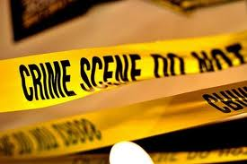
In this unit:
You will experience examining evidence ( things, suspects, observed data) and then making inferences ( possible hunches based on logic and reasoning).
The real world of police investigation will be brought to you as you learn to dust for fingerprints, examine handwriting for unique characteristics and analyze various substances.
When a crime scene is investigated by police, all clues are examined. These clues might include tire tracks, shoe prints, fingerprints, fibers, hair, written or print documents and soil evidence.

Slide 4
Activity # 1
What is the importance of observation in investigations?

Slide 5
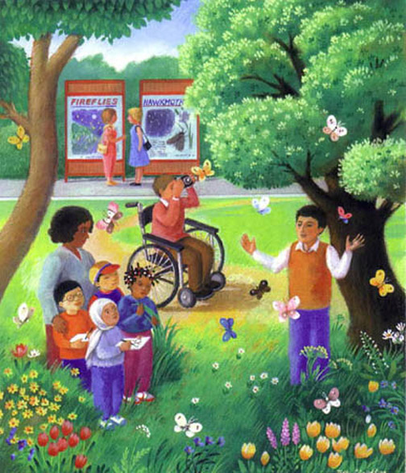
Quietly observe, and write down what is happening in this picture.

Slide 6
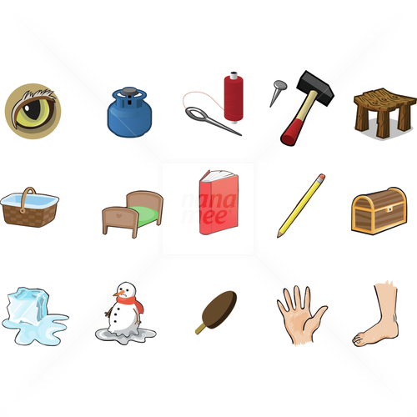
Observe the objects below for 15 seconds!

Slide 7
Challenge!!
List all the objects from the previous slide!
Hint : 15 objects in total!
How many can you remember?

Slide 8
How many did you remember correctly?
Eye
Propane tank
Needle and thread
Hammer and nail
Stool
Basket
Bed
Book
Pencil
Treasure chest
Ice cube
Snowman
Ice cream
Hand
foot

Slide 9
What was the difference between your observations of both pictures?
In the first picture you were prepared. You knew the purpose of your observation. A prepared observation will have more details and be more accurate because the observer will know what they are looking for.
In the second picture you were not prepared, you did not know what to look for in the picture. You were just casually observing the objects in the picture. Your observations will not be as accurate.

Slide 10
Activity: Ten (or fewer) Questions
The goal of the game is to discover the mystery person, place or thing in ten questions or less.
You may work in pairs, or groups of three.
Each question that furthers the discovery of the person, place of thing, is awarded one point.
Each question that does not further the investigation loses a point.
Each group in turn will ask a question, until the mystery is solved.

Slide 11
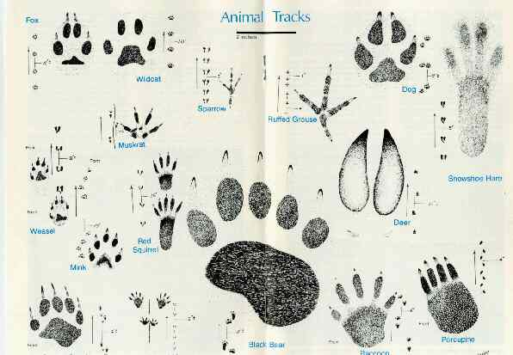
ANIMAL TRACKS

Slide 12
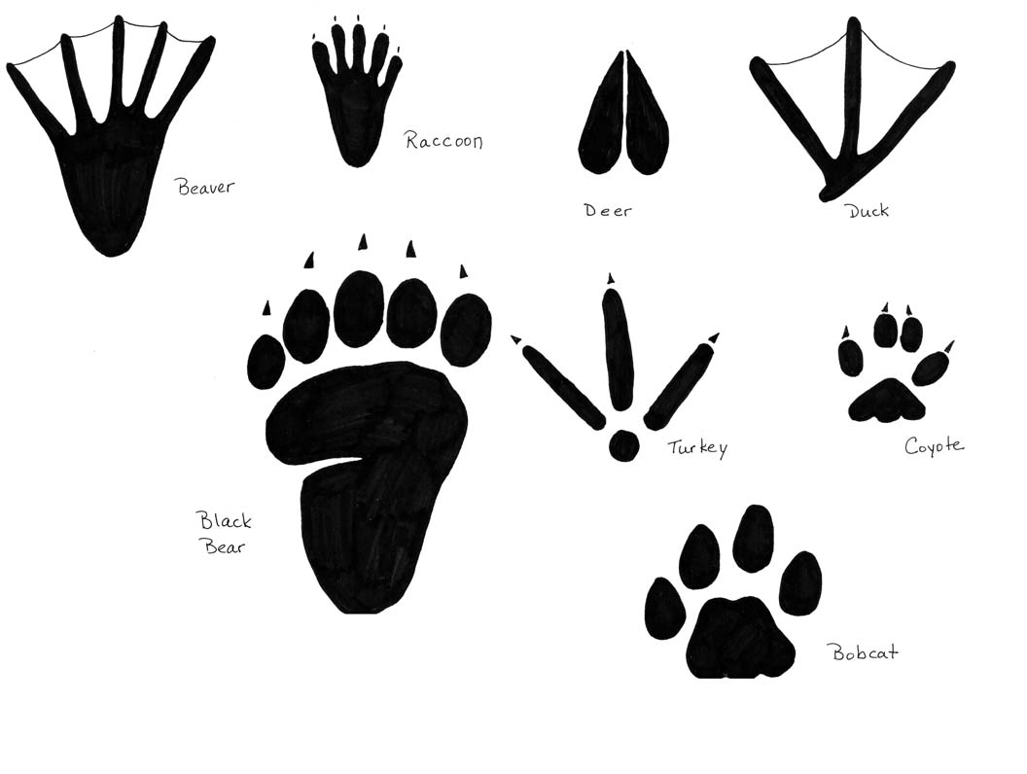

Slide 13
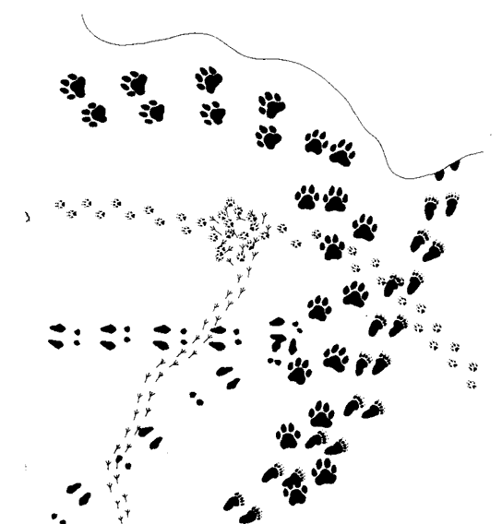
What Happened Here? How many animals were here? What were they doing? What kind of animals were they? Were they all here at the same time? What are the clues that can help you guess the answers to these questions? Think about all of the possibilities, and then write a report using your best guess about the story behind these footprints.

Slide 14
What is a Dichotomous Key?
A dichotomous key is a series of questions which leads to the identification of an item by going through a series of choices that leads the user to the correct name of the item. Dichotomous means "divided in two parts".
At each step of the process of using the key, the user is given two choices; each alternative leads to another question until the item is identified. (It's like playing 20 questions.)

Slide 15
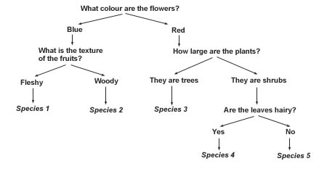

Slide 16
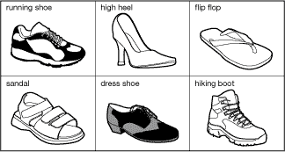
SHOE SORTING
The six objects are all shoes.
They all have different uses and shapes.

Slide 17
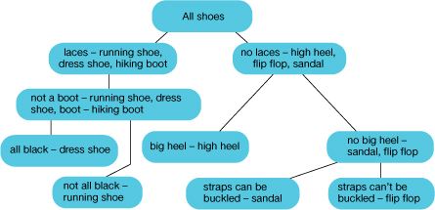
Shoe Sorting : Dichotomous Key

Slide 18
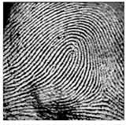
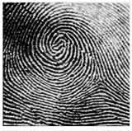
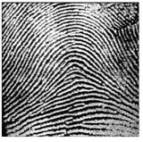
FINGERPRINTS
Fingerprints are an excellent way to identify suspects and record important clues found at the scene of the crime. A good detective knows how to dust for fingerprints and get them on paper.
Fingerprints are created by oil and sweat that collects between the ridges of skin on your fingers. When you touch a smooth or flat surface, a small pattern is created on that surface. Every single person in the world has a different set of fingerprints.
There are three basic types of fingerprint patterns:
Loop
Whorl
Arch

Slide 19
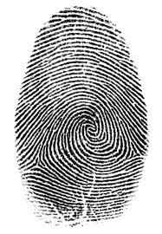
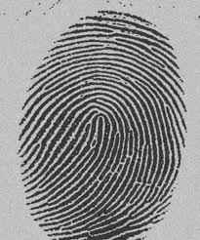
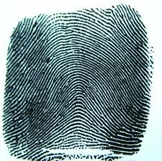
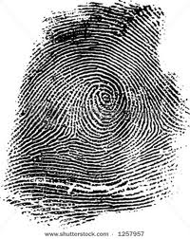
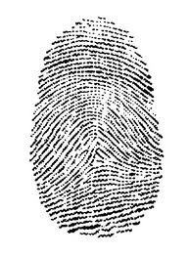
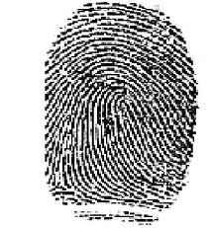
Identify each fingerprint pattern :

Slide 20
Ridge Characteristics
When the police identify fingerprints, the first thing they do is look at the pattern of the print i.e., loop, whorl, arch, or composite. Once they have a matching pattern type, they look for unique features of a print to help them match a suspect to the fingerprints found at the scene of a crime. In order for the print to be considered a “match” they must have a number of ridge characteristics in common. The following are 4 ridge characteristics they look for in a finger print.
Bifurication (fork) – one ridge splits to form two ridges and then rejoin to one ridge again, forming a shape like a lake.
Ridge endings – a ridge ends.
Island – A very short ridge in the print pattern is not connected to any other ridge, much like an island floating by itself.

Slide 22
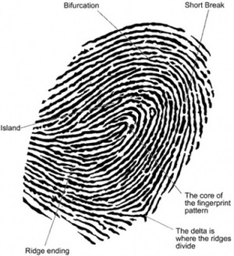

Slide 23
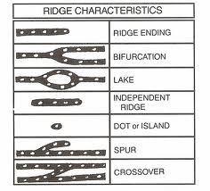

Slide 24
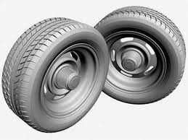
Tire Tracks
Do all tires have the same tread?

Slide 25
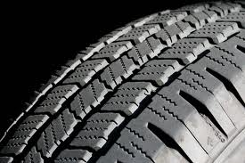
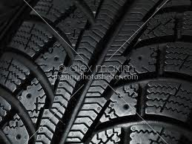
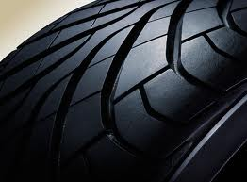
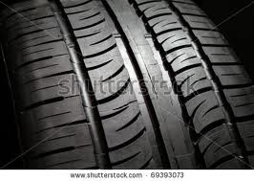
NO!

Slide 26
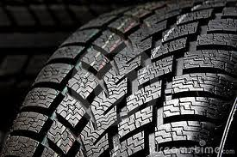
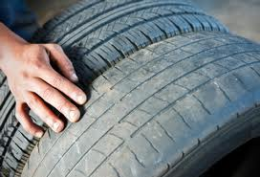
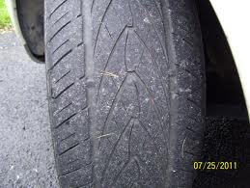
Did you notice the difference in the tread patterns?
Look for :
Spacing
Depth
Shape
Design
You might also notice:
Evidence of wear
Size
Possible damage to the tire surface

Slide 27
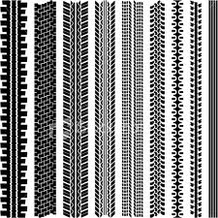
Tire Tracks

